Slide 1
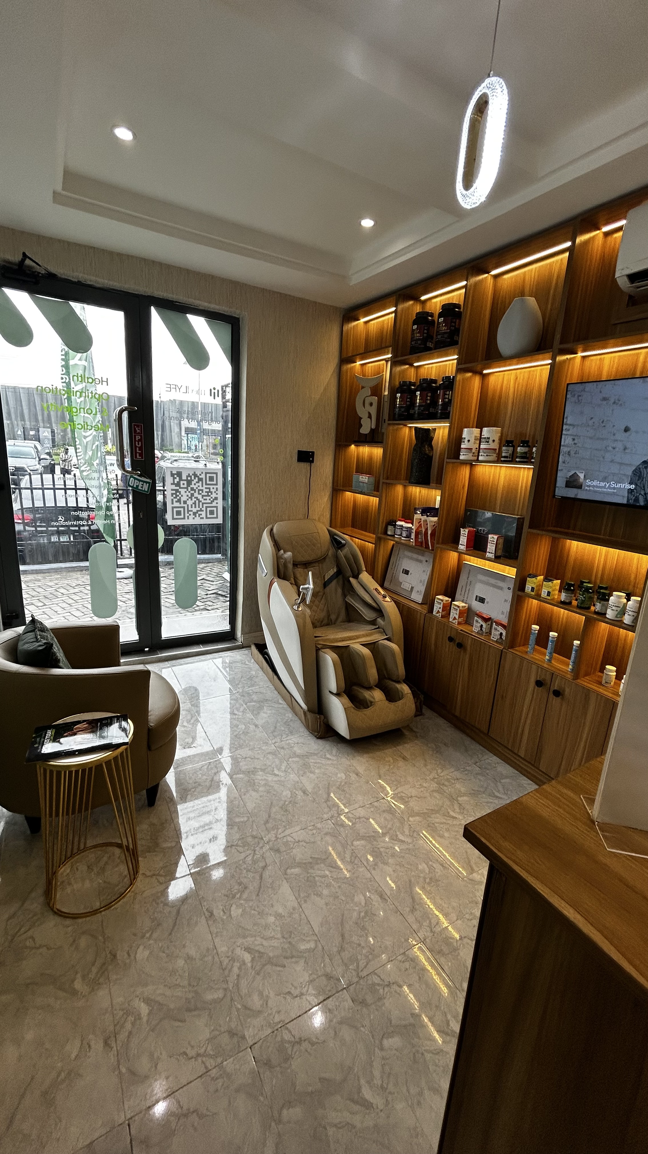



medLYFE
Wellness & Longevity Centre
DISCOVERY CALL
MedLYFE helps people
live better, longer
A science-led wellness and longevity centre for midlife optimization — built on advanced diagnostics, structured programs, and high-touch care.
Healthspan
Lifespan
Wellness
1

Slide 2
FOUNDATIONS
Start Today.
Bridge the Gap Tomorrow.
Understand the Basics
Two forces shape how you age — and the gap between them is where we work.
WHAT IS LONGEVITY?
Longevity is about living longer while maintaining health and vitality — extending both your lifespan and health span.
LIFE SPAN — how long you live.
Birth
End of Life
WHAT IS WELLNESS?
HEALTH SPAN — how well you live.
Wellness is how well you feel and function today — your energy, vitality, resilience and overall wellbeing.
Birth
End of Life
Many people spend their final years in decline — we close the gap by extending your health span.
WHAT IS HEALTH OPTIMIZATION?
Health optimization is the proactive process of improving how you feel, perform and function today, while building the foundation for a longer, healthier future.
→
→
Health
Optimization
Wellness
Longevity
2

Slide 3
THE PAYOFF
Why This Matters
Six reasons a longer health span changes everything.
More Good Years
Lower Risk
More Energy & Independence
Spend more of your life feeling your best.
Prevent and delay chronic disease and disability.
Stay active, capable and confident.
Better Quality of Life
A Legacy of Wellness
Long-Term Value
For you — and the people you love.
Your healthy choices ripple for generations.
Invest in your health today, for tomorrow.
Our goal: maximize your health span and protect your lifespan.
3

Slide 4

WHAT WE OPTIMIZE
The MedLYFE Optimization Pyramid
We go deeper than basic checkups: advanced diagnostics first, then structured layers of optimization — every program moves from insight to action to tracking.
Rule: we do not prescribe transformation before we understand the person.
Regenerative / Advanced Interventions
PRP . Exosomes . Stem Cell Support .Advanced Aesthetics/ Regenerative Therapies.
Peptides. Hormone Optimization .Gut / Metabolic Support . Targeted Prescriptions
Red Light . Compression Therapy . Brain Wellness-Neuro Calm
Oral Supplements . IV Nutrient Therapy . NAD+ Therapy . Targeted Nutraceuticals.
Sleep . Nutrition . Movement .Stress Management . Recovery
Medical Optimization
Wellness Technology
Supplementation & IV / NAD
Lifestyle Architecture
Advanced Diagnostics
Body Age Testing . Genetic Prediction . Advanced Biomarkers .Microbiome Testing . Hormone Analysis
2

Slide 5
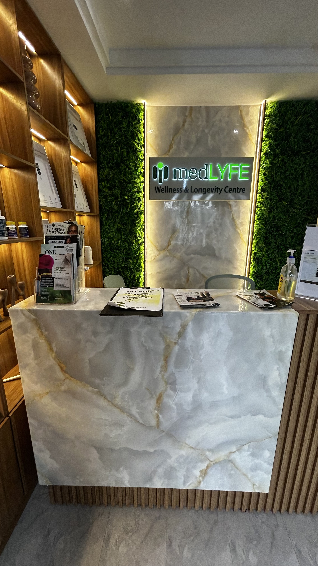

WHY ADVANCED DIAGNOSTICS
We don't guess. We test, then we act.
Midlife is when people start feeling the gap — energy, sleep, hormones and resilience shift before disease shows up. Advanced diagnostics uncover the root cause, so the plan is built around real data, not guesswork.
Clarity before treatment
You see the full picture — biomarkers, risk and root cause — before any program begins.
A plan built on evidence
Every recommendation traces back to your own data, not generic advice.
Progress you can track
Baseline data means we can measure real change, visit after visit.
3

Slide 6



PROGRAM OPTIONS
One clear ladder: entry → core → complete longevity
Choose the path that fits where you are today.
2–5 HOURS
3–6 MONTHS
6–12 MONTHS
MedLYFE Longevity Day
Core Optimization Programs
MedLYFE 360
The definitive 6–12 month transformation journey
Advanced Diagnostics
Coaching
Wellness Technology
Reviews
Executive-Level Support
→
→
A Premium First Step
Setting the tone from day one
Health Check
Consultations
IV / NAD Therapy
Recovery/reset experience
Skin reset
A structured pathway to sustained transformation
Weight & Metabolic
Skin , Hair & Aesthetics
Hormone & Sexual health
Gut
Sleep Optimization
4

Slide 7
INVESTMENT
What each path costs
Guide pricing — your exact investment is confirmed after your diagnostic consultation.
2–5 HOURS
3–6 MONTHS
6–12 MONTHS
MedLYFE Longevity Day
Core Optimization Programs
MedLYFE 360
₦50,000+
per single-day visit
Final cost depends on the specific service selected — diagnostics, IV therapy or recovery add-ons.
→
₦500,000+
for the 3–6 month program
Investment varies by focus area — weight, hormones, skin, gut or sleep — and diagnostic depth.
→
₦3,000,000+
for the 6–12 month journey
Includes advanced diagnostics, coaching, wellness technology and executive-level support.
5

Slide 8

YOUR NEXT STEP
Let's build your plan
medLYFE
We do not need to wait for disease to start optimizing. The next step is simple — book your Longevity Day or a full consultation, and we'll recommend the program pathway that fits your goals.
Wellness & Longevity Centre
Visit us
Lekki, Lagos
Call / WhatsApp
Scan the QR code at reception
or ask our front desk team
Discretion guaranteed
Private, physician-led care
Book your visit
Choose the Longevity Day or schedule a full consultation with our team.
Meet our physicians
Discuss goals, history and concerns with a doctor-led care team.
Get your plan
Receive a structured pathway, backed by diagnostics and ongoing tracking.
6

